Slide 1
Red Hat AMQ Streams Architecture
Chatchai Kongmanee
Specialist Solution Architect
Red Hat, Thailand

Slide 2



AMQ Streams
Zookeeper (for Kafka only)
HTTP Proxy
Broker
Connect
Producer API
Mirror Maker
Consumer API
Streams API
Operators
Admin API
Notes:
AMQ Streams simplifies the process of running Apache Kafka in an OpenShift cluster and RHEL.
It have capabilities and component architecture of Kafka can deliver, all of kafka ecosystem components plus add on component such as Operator for openshift deployment,
HTTP Proxy for bridge REST API to Kafka, kafka exporter for monitor topic/partition and lag of consumer , and cruise control for automatic rebalance partition
Plus support service from red hat,

Slide 3
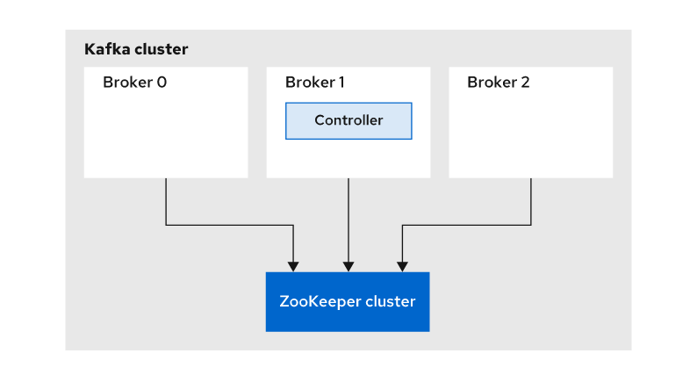
Kafka Cluster
Kafka is composed of several servers that allow horizontal scaling.
A Kafka server is called a broker. When several brokers work together, this is called a cluster.
Because brokers are independent instances, they have to communicate over a network to share information about failures or updates. Apache ZooKeeper is used by Kafka to perform operations such as selecting a controller broker, notifying the controller broker that another broker is joining or leaving the cluster, or handling topic creation/removal.

Slide 4

ZooKeeper
Electing controller
Zookeeper is used to elect a controller, make sure there is only one and elect a new one it if it crashes
Cluster membership
Which brokers are alive and part of the cluster? This is also managed through ZooKeeper
Topic configuration
Which topics exist, how many partitions each has, where are the replicas, who is the preferred leader, what configuration overrides are set for each topic
Quotas and ACLs
SCRAM-SHA users

Slide 5

ZooKeeper
KIP-500
Plans to remove ZooKeeper from Kafka
ZooKeeper will not be replaced by some similar project
Kafka will use Raft based protocol to replace ZooKeeper internally
This will take time over many releases
Changing everything currently stored in ZooKeeper to Kafka
Changing many management tools
Tools
Clients
* KIP-500 (not cover in this course)

Slide 6
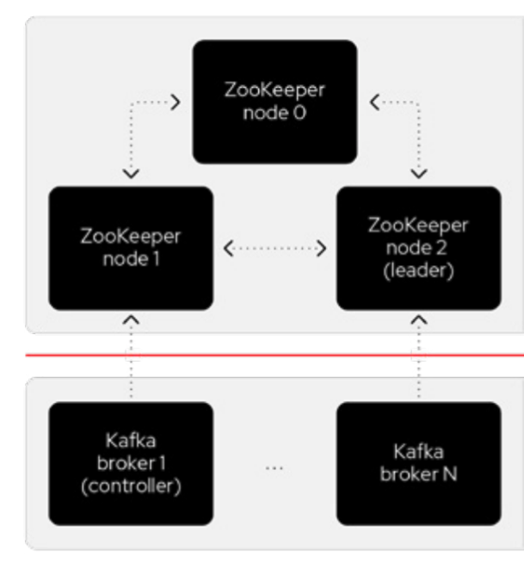
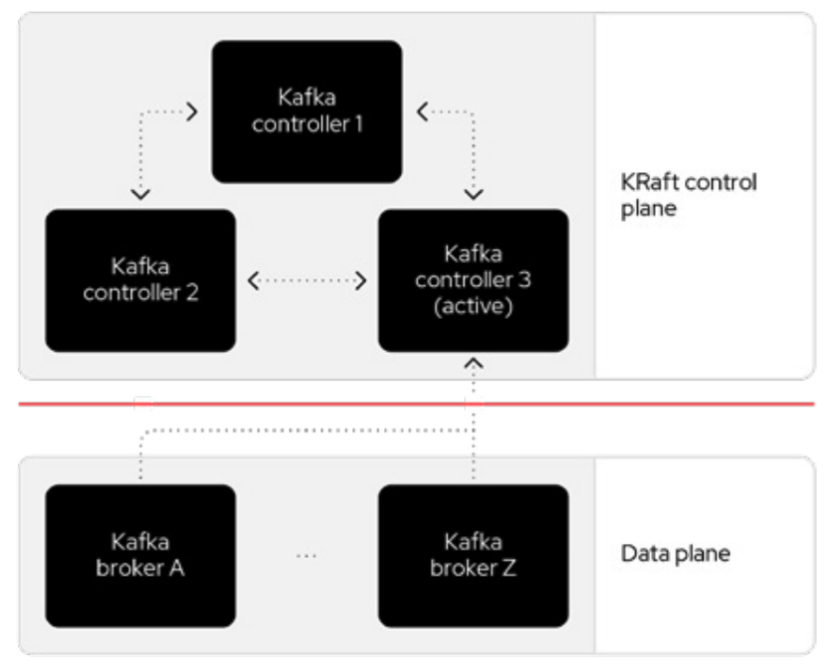
Zookeeper Removal (TP)
EVENT-DRIVEN ARCHITECTURE
Zookeeper architecture for Kafka
KRaft architecture for Kafka
Source: https://www.redhat.com/en/resources/high-availability-for-apache-kafka-detail
Notes:
A Kafka cluster can be broken down into two components: a control plane and a data plane, each with its own responsibilities that work together to transfer data where it needs to go.
Historically, Kafka used an Apache ZooKeeper cluster to provide most of its control plane functionality. ZooKeeper tracks each broker and provides replicated and consistent storage for the cluster metadata. ZooKeeper also elects one Kafka broker to be the controller. The controller has extra, non data plane duties to manage the state of the cluster, such as responding to brokers that crash or restart.
The new architecture removes the ZooKeeper dependency and replaces it with a flavor of the Raft consensus protocol, allowing each server in the Kafka cluster to take the role of broker, controller, or both. The controller cluster will perform the same roles as the cluster of ZooKeeper nodes did previously, but the Kafka controller will now be elected from the controllers instead of the brokers.

Slide 7
ZooKeeper
Zookeeper cluster always needs majority of nodes available
Deployed in odd number of nodes
Requires odd number of racks / availability zones / datacenters
Typical deployments have 3, 5 or 7 nodes
Clusters with even number of nodes work, but do no improve HA
Adding nodes delivers only limited performance gains but it improves HA
Our general recommendation is to use dedicated Zookeeper cluster per Kafka cluster
But in special cases we can accept reusing existing clusters
OpenShift deployment currently always deploys its own Zookeeper
In the latest Kafka versions Zookeeper is not used as heavily as it used to in the past
Things such as consumer offsets are now stored in Kafka

Slide 8
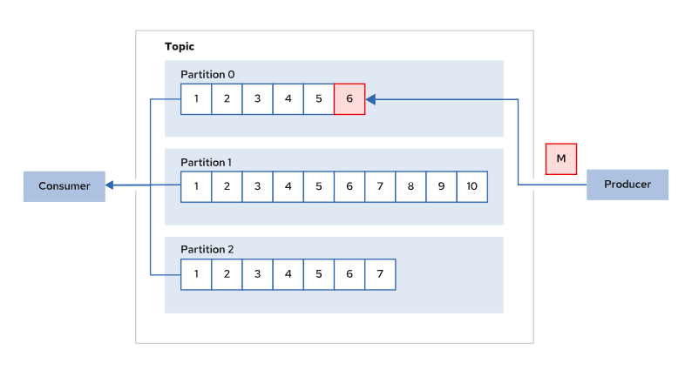
Messages and Topics
Messages / records are sent to / received from topic
Topics are split into one or more partitions
Partition = Shard
All actual work is done on partition level, topic is just a virtual object
Each message is written only into a one selected partition
Partitioning is usually done based on the message key
Message ordering within the partition is fixed
Clean-up policies
Based on size / message age or compacted based on message key

Slide 9
Kafka Topics
A topic is a logical group for related records. Each topic has one or more partitions. In Kafka, topics have the following properties:
Multi-subscriber and Multi-producer
Durable
In Kafka, topics are durable. Kafka brokers store the records for a specified duration (7 days or 604800000 ms by default).
Consequently, when a consumer fails, it can use several error recovery strategies, such as:
Process all of the records in the topic again.
Process records from the last processed record.
Process records from a specified offset.
Unordered (except 1 partition)
Pull-only
Producers push records to Kafka brokers. Consumers poll records from each partition of a topic.
Kafka brokers do not push records to consumers. This enables Kafka to lower its overhead for each record and withstand consumer and producer scaling.
Append-only
Producers can only append new records to a topic.
Because Kafka brokers do not parse records in a topic, brokers cannot perform any functions on a record, such as delete or modify.
Brokers delete records only after the configured retention period for a record expires.
Notes:
Multiple independent producers can send records to one topic. Similarly, multiple independent consumers can consume the same message. Consumers specify what message to read based on message offset.

Slide 10
Topics & Partitions
Topic
Partition 0
M₁
M
M
M
M
M
M
M
M
Producer
Offset 0
Offset 1
Offset 2
Offset 3
Offset 4
Offset 5
Offset 6
Offset 7
Partition 1
M₂
M
M
M
M
M
Offset 0
Offset 1
Offset 2
Offset 3
Offset 4
Partition 2
M₃
M
M
M
M
M
M
M
Offset 0
Offset 1
Offset 2
Offset 3
Offset 4
Offset 5
Offset 6
Older
Newer

Slide 11
Topics & Partitions
Topic
Partition 0
M
M
M
M
M
M
M
M
M₄
M₅
Offset 0
Offset 1
Offset 2
Offset 3
Offset 4
Offset 5
Offset 6
Offset 7
Consumer
Partition 1
M
M
M
M
M
M₁
M₂
Offset 0
Offset 1
Offset 2
Offset 3
Offset 4
Partition 2
M
M
M
M
M
M
M
M₃
M₄
Offset 0
Offset 1
Offset 2
Offset 3
Offset 4
Offset 5
Offset 6
Older
Newer

Slide 12

Message Replay
M₀
M₄
M₂
Loader
M₅
M₁
M₃
M₆
Offset 0
Offset 1
Offset 2
Offset 3
Offset 4
Offset 5
Offset 6
Offset 7
M
M
M
M
M
M
M
M₀
M₄
M₂
M₅
M₁
M₃
M₆

Slide 13
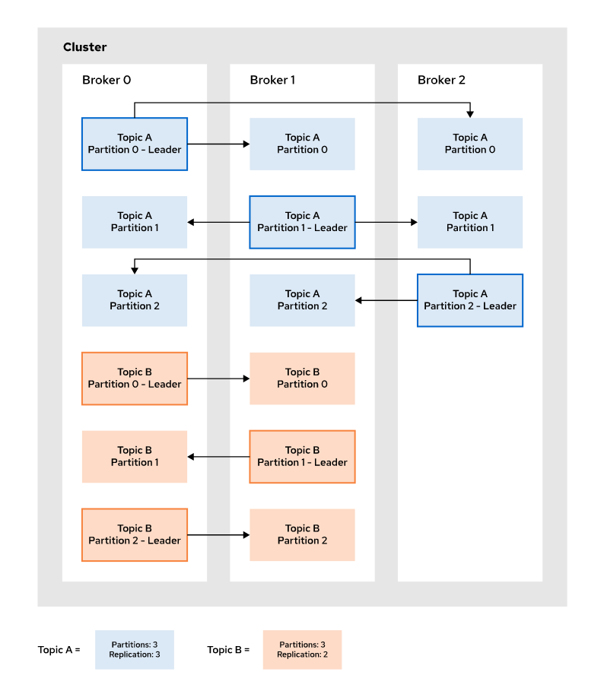
Replication
Replicas are “backup” for a partition
Provide redundancy
It’s the way Kafka guarantees availability and durability in case of node failures
Two roles :
Leader : a replica used by producers for sending messages
Followers : all the other replicas
They replicate messages from the leader to be “in-sync” (ISR)
Since 2.4.0 can serve consumers (KIP-392)
A replica changes its role as brokers come and go
https://cwiki.apache.org/confluence/display/KAFKA/KIP-392%3A+Allow+consumers+to+fetch+from+closest+replica
Notes:
Describing How Kafka Achieves Scalability and Availability
To achieve scalability, partitions of a topic are split across the different brokers of the cluster. This enables a topic to be scaled horizontally, which means that the workload is distributed across different brokers, instead of providing more resources to a single broker to cope with all the workload. Consumers of a topic can read messages from different machines, avoiding all requests being sent to the same broker.
At the same time, every partition is replicated to provide data redundancy in case of failure. These replicas are spread across the Kafka brokers in the cluster. Among these replicas located in different brokers, Kafka selects a leader by applying an election algorithm.
Producers and consumers only write and read data from the partition leader, and then the data is propagated to the replicas. If the broker that contains the partition leader goes down, Kafka selects another leader among the remaining replicas. This way, data is always available.
For example, consider a cluster with 3 brokers. If you create a topic named Topic A with 3 partitions and 2 replicas per partition, then a possible layout for the cluster is illustrated in the following diagram.
Every partition leader is a different broker, which ensures that consumers will read from different machines. At the same time, every broker holds a replica for every partition. In the case that, for example, Broker 0 goes down, Partition 0 will need a new leader, which will be one of the replicas in Broker 1 or Broker 2.

Slide 14
Replication
Broker C
Topic 1
Broker A
Partition 0 > Repl 3
(Follower)
Topic 1
Broker B
Partition 1 > Repl 2
(Follower)
Partition 0 > Repl 1 (Leader)
Topic 1
Partition 1 > Repl 1
(Follower)
Partition 0 > Repl 2
(Follower)
Partition 2 > Repl 3
(Leader)
Partition 2 > Repl 1
(Follower)
Partition 1 > Repl 2
(Leader)
Partition 2 > Repl 2
(Follower)
Leaders and followers spread across the cluster.
Notes:
Partition เพิ่มได้ ลดไม่ได้
Replica ปรับไม่ได้
Partition, replica ย้ายได้ (reassign)

Slide 15
Replication
Broker A
Broker B
Broker C
Topic 1
Topic 1
Topic 1
Partition 0 > Repl 1 (Leader)
Partition 0 > Repl 2
(Follower)
Partition 0 > Repl 3
(Follower)
Partition 1 > Repl 1
(Follower)
Partition 1 > Repl 2
(Leader)
Partition 1 > Repl 3
(Follower)
Partition 2 > Repl 1
(Follower)
Partition 2 > Repl 2
(Follower)
Partition 2 > Repl 2
(Leader)
Partition 2 > Repl 3
(Leader)

Slide 16
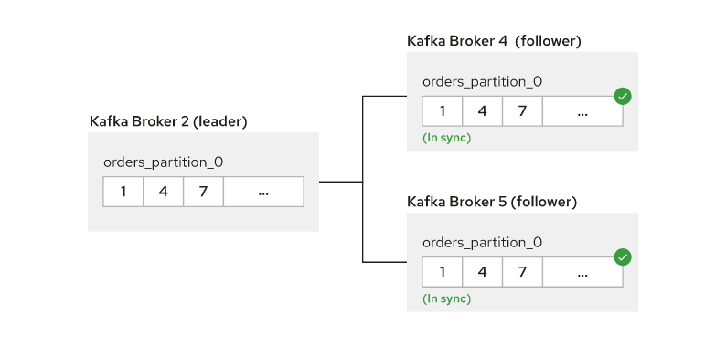
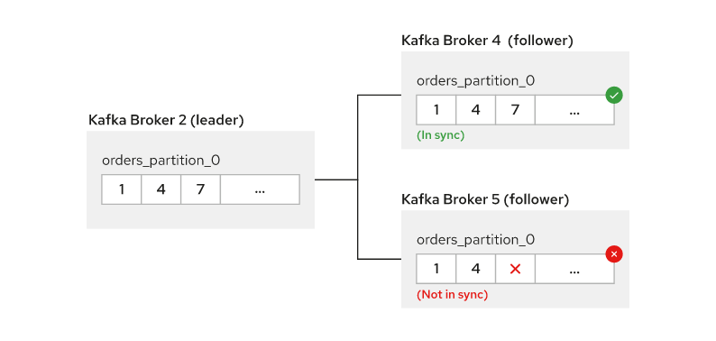
Replication
When followers contain the same partition records as the leader, they become in-sync replicas (ISR)
Replicating number N means a topic can overcome N-1 broker failures for each partition.
multiple partitions benefits
scalability, distributed among multiple brokers.
failure resiliency
throughput, multiple instances of consumer
high number of partitions come with a number of tradeoffs, such as:
Increasing ordering complexity, consumers poll partitions in random order.
Increasing management overhead
Notes:
For example, if you configure the replication factor to 4, this means that N=4 and your Kafka cluster is resilient for up to three replica failures.
Separating each topic into independent partitions is crucial for scalability of individual topics. Creating multiple partitions can bring benefits, such as:
Increasing topic scalability, because topic load is distributed among multiple brokers.
Increasing topic failure resiliency, because a broker failure influences a smaller portion of the topic.
Increasing topic throughput, because multiple instances of one consumer can connect to a subset of partitions from one topic.
Additionally, you can scale each partition individually by changing the replication number.
However, a high number of partitions come with a number of tradeoffs, such as:
Increasing ordering complexity, because consumers poll partitions in random order.
Increasing management overhead, because consumers and producers must keep track of all of the partitions. Additionally, ZooKeeper maintains information about each partition broker. Leader election for each partition can become costly. The Kafka cluster also maintains information about each partition, such as message offset for each consumer in each partition.

Slide 17

Compacted topics
Key-Based Retention Using Topic Compaction
Joe
Jakub
Jakub
Frank
Frank
Key
Joe
Jakub
Frank
Frank
Joe
New York
Prague
Olomouc
Madrid
London
Value
null
Prague
Paris
Madrid
null
Notes:
Key-Based Retention Using Topic Compaction

Slide 18
Clients
They are really “smart” (unlike “traditional” messaging)
Configured with a “bootstrap servers” list for fetching first metadata
Where are topics the client is interested in?
Connect to broker which holds partition leaders or followers
Producer specifies destination partition
Consumer handles messages offsets to read
If error happens, refresh metadata (something is changed in the cluster)
Batching on producing/consuming

Slide 19
Discovery
Discovery mechanism in Kafka clients
Kafka client
1. Connect to any of the brokers and get the metadata
Kafka cluster
2. Receive the metadata
3. Open connections to the specific brokers based on the metadata

Slide 20
Clients
Consumer 1
Broker A
Broker B
Broker C
Topic 1
Topic 1
Topic 1
Partition 0 > Repl 1 (Leader)
Partition 0 > Repl 2
(Follower)
Partition 0 > Repl 3
(Follower)
Partition 1 > Repl 1
(Follower)
Partition 1 > Repl 2
(Leader)
Partition 1 > Repl 3
(Follower)
Partition 2 > Repl 1
(Follower)
Partition 2 > Repl 2
(Follower)
Partition 2 > Repl 3
(Leader)
Producer
Consumer 2

Slide 21
Protocol
It’s non-standard, binary protocol over TCP
Request/Response message pairs
All requests are initiated by the client
A client could be a broker as well, for inter-broker communication (i.e. followers)
APIs
Core client requests (metadata, send, fetch, offsets management)
Group membership (join, sync, leave) and heartbeat
Administrative (describe, list, …)
Evolves with every Kafka version

Slide 22
Protocol
API key
API version
Correlation id
Client
id
Request
Message
Metadata
Req.
Produce
Req.
Fetch
Req.
Offset
Req.
Offset Commit Req.
Offset
Fetch Req.
...
Correlation
id
Response
Message
Metadata
Res.
Produce
Res.
Fetch
Res.
Offset
Res.
Offset Commit Res.
Offset
Fetch Res.
...

Slide 23
Protocol
Messages are “batched”
Messages are simply byte arrays
Timestamp : create or log append
Key : used for specifying the destination partition
Value : with custom payload
Header : with key-value pairs
First
Offset
Length
...
Records
Length
Attributes
Timestamp
Offset
Key
Value
Headers
Notes:
A batch is a group of records that are sent together to the Kafka broker. Sending individual records to Kafka would lead into a lot of networking traffic and overhead. At the same time, batches are usually compressed for more efficient data transfer and storage.

Slide 24
Controller
The controller is one of the brokers and it is responsible for maintaining the leader/follower relationship for all the partitions
When a node shuts down, it is the controller that tells other replicas to become partition leaders to replace the partition leaders on the node that is going away
In rolling update, take down the controller last to avoid multiple controller elections
Elected through Zookeeper
Notes:
zookeeper-shell.sh [ZK_IP] get /controller

Slide 25
Internals
What makes Kafka fast?
Zero-copy
it calls the OS kernel direct rather than at the application layer to move data fast
It works if clients speak same protocol version, otherwise in-memory copy
Batching data
batching the data into chunks. This minimises cross-machine latency with all the buffering/copying that accompanies this

Slide 26
Internals
What makes Kafka fast? (cont.)
Avoids random disk access
an immutable commit log it does not need to rewind the disk and do many random I/O operations and can just access the disk in a sequential manner
Horizontal scaling
ability to have thousands of partitions for a single topic spread among thousands of machines means Kafka can handle huge loads

Slide 27
Usual setups
Clusters with 3 or more Kafka nodes
Does not need to be odd number of nodes
Replication settings depend on data
3 replicas with minimum of ISR replicas 2 is common
Partitions
Depends on expected number of consumers
Pick rather more than less, especially if messages have keys
Too many have performance impact!
Rack awareness
On OCP
Always use resources requests
Configure JVM options to set -Xmx
Dedicated nodes for Kafka are not required, but are recommended

Slide 28
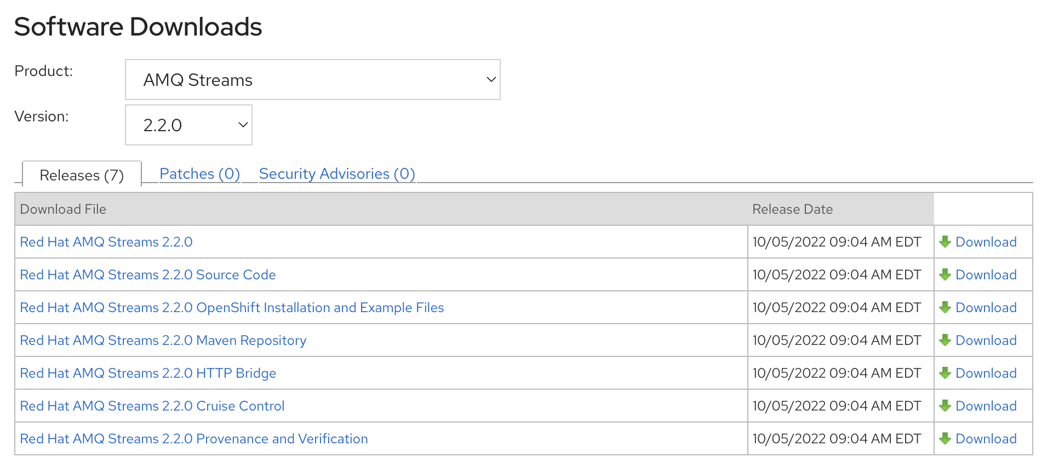
Setup & Configuration
Download from Red Hat → https://access.redhat.com/jbossnetwork/restricted/listSoftware.html?downloadType=distributions&product=jboss.amq.streams

Slide 29
Setup & Configuration
Support Configuration → https://access.redhat.com/articles/6644711
Latest Version (2.2 LTS)
OCP version 4.8, 4.9,4.10 & 4.11 on x86_64, s390x, & ppc64le
RHEL 7 & 8 with Open JDK 8 & 11, Oracle JDK 8 & 11, IBM JDK 8 **
Extract AMQ Streams Zip to your installation directory
Create User & Group for AMQ Streams
Create Zookeeper Data Directory & Kafka Data Directory

Slide 30
Data storage considerations
An efficient data storage infrastructure is essential to the optimal performance of AMQ Streams.
Block storage is required. File storage, such as NFS, does not work with Kafka.
Choose from one of the following options for your block storage:
Cloud-based block storage solutions, such as Amazon Elastic Block Store (EBS)
Local storage
Storage Area Network (SAN) volumes accessed by a protocol such as Fibre Channel or iSCSI
AMQ Streams is compatible with the XFS and ext4 file systems, which are commonly used with Kafka.
Use separate disks for Apache Kafka and ZooKeeper.
Kafka supports JBOD (Just a Bunch of Disks) storage, JBOD provides increased data storage for Kafka brokers. It can also improve performance. https://access.redhat.com/solutions/343543
SSDs are particularly effective with ZooKeeper, which requires fast, low latency data access.

Slide 31
Running a single-node Kafka cluster
Edit the ZooKeeper configuration file such as /opt/kafka/config/zookeeper.properties. Set the dataDir option to /var/lib/zookeeper/:
dataDir=/var/lib/zookeeper/
Edit the Kafka configuration file /opt/kafka/config/server.properties. Set the log.dirs option to /var/lib/kafka/:
log.dirs=/var/lib/kafka/
Start Zookeeper such as
/opt/kafka/bin/zookeeper-server-start.sh -daemon /opt/kafka/config/zookeeper.properties
Check that ZooKeeper is running:
jcmd | grep zookeeper
Return
number org.apache.zookeeper.server.quorum.QuorumPeerMain /opt/kafka/config/zookeeper.properties
Start Kafka such as
/opt/kafka/bin/kafka-server-start.sh -daemon /opt/kafka/config/server.properties
Check that Kafka is running:
jcmd | grep kafka
Return
number kafka.Kafka /opt/kafka/config/server.properties
* Both running in same host

Slide 32
Sending and receiving messages from a topic
Start the Kafka console producer and configure it to send messages to a new topic
/opt/kafka/bin/kafka-console-producer.sh --broker-list localhost:9092 --topic my-topic
Enter several messages into the console. Press Enter to send each individual message to your new topic
>message 1
>message 2
In a new terminal window, start the Kafka console consumer and configure it to read messages from the beginning of your new topic.
/opt/kafka/bin/kafka-console-consumer.sh --bootstrap-server localhost:9092 --topic my-topic --from-beginning
Check that they display in the consumer console.
Stop the Kafka console producer and then the consumer by pressing Ctrl+C.
* Don’t required create topic because set auto.create.topics.enable=true

Slide 33
Stopping the AMQ Streams services
Stop Kafka Broker
/opt/kafka/bin/kafka-server-stop.sh
Stop Zookeeper
/opt/kafka/bin/zookeeper-server-stop.sh
Check Process
jcmd

Slide 34
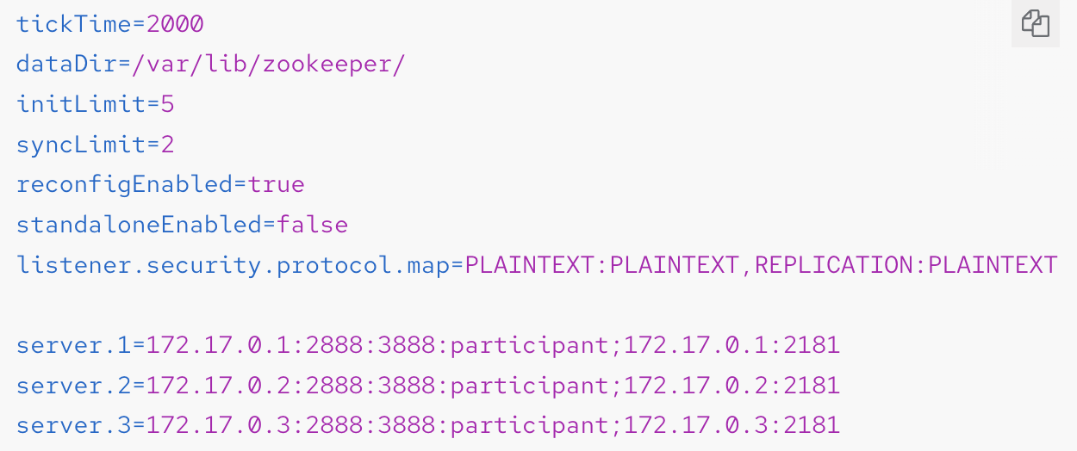
Running a multi-node ZooKeeper cluster
Create the myid file in /var/lib/zookeeper/. Enter ID 1 for the first ZooKeeper node, 2 for the second ZooKeeper node, and so on. For example
echo "1" > /var/lib/zookeeper/myid
Edit the ZooKeeper /opt/kafka/config/zookeeper.properties configuration file for the following:
Set the option dataDir to /var/lib/zookeeper/.
Configure the initLimit and syncLimit options.
Configure the reconfigEnabled and standaloneEnabled options.
Add a list of all ZooKeeper nodes. The list should include also the current node.
Example configuration for a node of ZooKeeper cluster with 3 members
Notes:
The new entry, initLimit is timeouts ZooKeeper uses to limit the length of time the ZooKeeper servers in quorum have to connect to a leader. The entry syncLimit limits how far out of date a server can be from a leader.
With both of these timeouts, you specify the unit of time using tickTime. In this example, the timeout for initLimit is 5 ticks at 2000 milleseconds a tick, or 10 seconds.
reconfigEnabled way to disable dynamic reconfiguration feature.
standaloneEnabled Standalone mode or in a Distributed mode

Slide 35
Running a Multi-node Zookeeper cluster
Start ZooKeeper with the default configuration file.
/opt/kafka/bin/zookeeper-server-start.sh -daemon /opt/kafka/config/zookeeper.properties
Verify that ZooKeeper is running with “jcmd” command.
Repeat this procedure on all the nodes of the cluster.
Verify that all nodes are members of the cluster by sending a stat command to each of the nodes using the ncat utility.
echo stat | ncat localhost 2181

Slide 36
Configuring ZooKeeper
tickTime : ZooKeeper’s basic time unit in milliseconds. It is used for heartbeats and session timeouts. For example, minimum session timeout will be two ticks.
dataDir : The directory where ZooKeeper stores its transaction logs and snapshots of its in-memory database. This should be set to the /var/lib/zookeeper/ directory that was created during installation.
clientPort : Port number where clients can connect. Defaults to 2181.
initLimit : Amount of time to allow followers to connect and sync to the cluster leader. The time is specified as a number of ticks.
syncLimit : Amount of time for which followers can be behind the leader. The time is specified as a number of ticks.
reconfigEnabled : Enables or disables dynamic reconfiguration. Must be enabled in order to add or remove servers to a ZooKeeper cluster.
standaloneEnabled : Enables or disables standalone mode, where ZooKeeper runs with only one server.
server.id : a list of servers which should be members of the ZooKeeper cluster.
server.<id> = <zk_host_address>:<zk_port_1>:<zk_port_2>[:<zk_role>];[<client_port_address>:]<client_port>
port1 : The port number used for intra-cluster communication.
port2 : The port number used for leader election.
zk_role : default is “participant”
client : address and port for client connection

Slide 37
Configuring ZooKeeper
myid files
Each node in the ZooKeeper cluster must be assigned a unique ID. Each node’s ID must be configured in a myid file and stored in the dataDir folder, like /var/lib/zookeeper/.
Logging
ZooKeeper is using log4j as their logging infrastructure. Logging configuration is by default read from the log4j.properties configuration file which should be placed either in the /opt/kafka/config/ directory or in the classpath. The location and name of the configuration file can be changed using the Java property log4j.configuration which can be passed to ZooKeeper using the KAFKA_LOG4J_OPTS environment variable:
export KAFKA_LOG4J_OPTS="-Dlog4j.configuration=file:/my/path/to/log4j.properties";

Slide 38
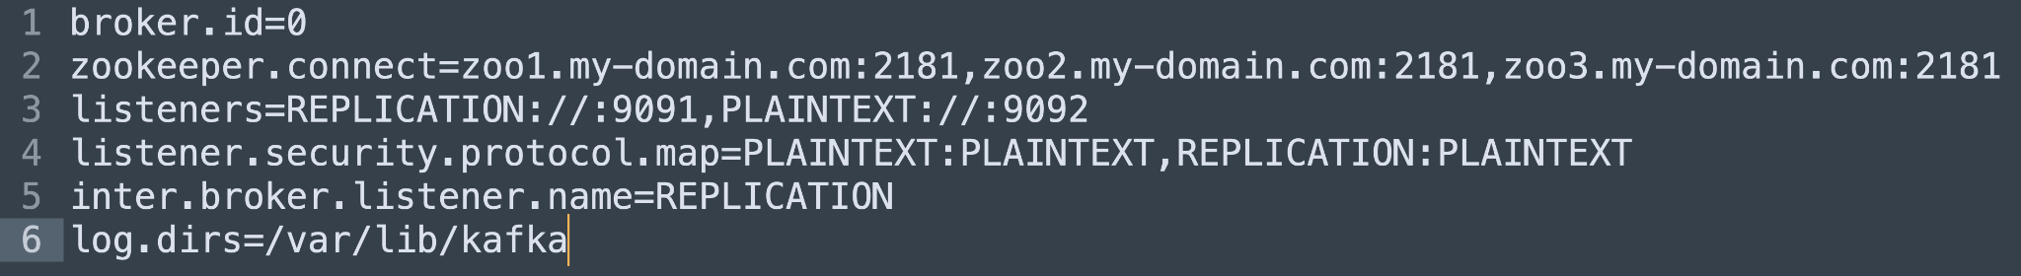
Running a Multi-node Kafka cluster
Edit the /opt/kafka/config/server.properties Kafka configuration file as follows:
Set the broker.id field to 0 for the first broker, 1 for the second broker, and so on.
Configure the details for connecting to ZooKeeper in the zookeeper.connect option.
Configure the Kafka listeners.
Set the directories where the commit logs should be stored in the logs.dir directory.
Here we see an example configuration for a Kafka broker:

Slide 39
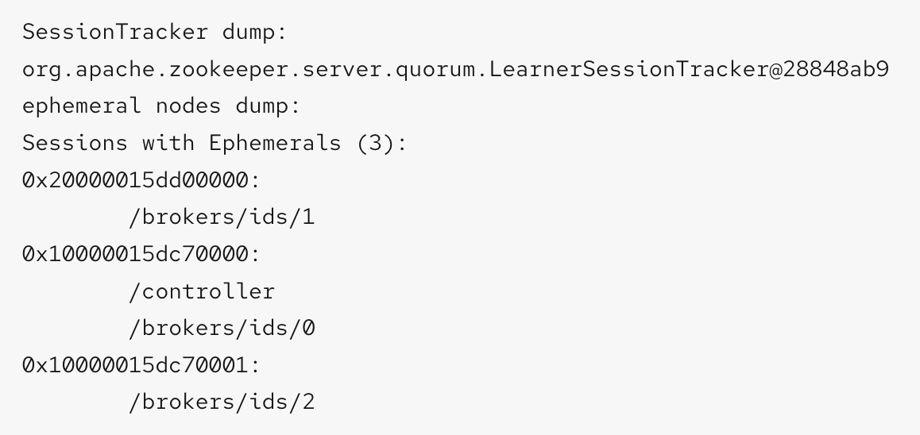
Running a Multi-node Kafka cluster
Start the Kafka broker with the default configuration file.
/opt/kafka/bin/kafka-server-start.sh -daemon /opt/kafka/config/server.properties
Verify that the Kafka broker is running.
jcmd | grep Kafka
Repeat this procedure on all the nodes of the cluster.
Verify that all nodes are members of the Kafka cluster by sending a dump command to one of the ZooKeeper nodes using the ncat utility.
echo dump | ncat zoo1.my-domain.com 2181
Example output

Slide 40
Configuring Kafka
zookeeper.connect : contains a comma-separated list of hostnames and ports of members of the zookeeper cluster.
zookeeper.connect=zoo1.my-domain.com:2181,zoo2.my-domain.com:2181,zoo3.my-domain.com:2181
listeners : used to connect to Kafka brokers. Each Kafka broker can be configured to use multiple listeners. Each listener requires a different configuration so it can listen on a different port or network interface.
listeners=internal-1://:9092,internal-2://:9093,replication://:9094
advertised.listeners : Optionally, to provide the client with a different set of listener addresses than those given in the listeners property. such as a proxy, is between the client and the broker, or an external DNS name is being used instead of an IP address. The names of the advertised listeners must match those listed in the listeners property.
advertised.listeners=internal-1://my-broker-1.my-domain.com:1234,internal-2://my-broker-1.my-domain.com:1235
inter.broker.listener.name : used for communication between Kafka brokers (Coordinating workloads, Replicating messages, Handling administrative tasks from the controller, such as partition leadership changes)
listeners=REPLICATION://0.0.0.0:9091
inter.broker.listener.name=REPLICATION
control.plane.listener.name : By default, communication between the controller and other brokers uses the inter-broker listener. The controller is responsible for coordinating administrative tasks, such as partition leadership changes.
listeners=CONTROLLER://0.0.0.0:9090,REPLICATION://0.0.0.0:9091
...
control.plane.listener.name=CONTROLLER

Slide 41
Configuring Topic
auto.create.topics.enable : by default, automatically create that topic (true)
Topic configuration : Auto-created topics will use the default topic configuration which can be specified in the broker properties file. However, when creating topics manually, their configuration can be specified at creation time. It is also possible to change a topic’s configuration after it has been created.
cleanup.policy : Configures the retention policy to delete or compact. The delete policy will delete old records. The compact policy will enable log compaction. The default value is delete.
compression.type : Specifies the compression which is used for stored messages. Valid values are gzip, snappy, lz4, uncompressed and producer (retain the compression codec used by the producer). The default value is producer.
max.message.bytes : The maximum size of a batch of messages allowed by the Kafka broker, in bytes. The default value is 1000012.
min.insync.replicas : The minimum number of replicas which must be in sync for a write to be considered successful. The default value is 1.
retention.ms : Maximum number of milliseconds for which log segments will be retained. Log segments older than this value will be deleted. The default value is 604800000 (7 days).
retention.bytes : The maximum number of bytes a partition will retain. Once the partition size grows over this limit, the oldest log segments will be deleted. Value of -1 indicates no limit. The default value is -1.
segment.bytes : The maximum file size of a single commit log segment file in bytes. When the segment reaches its size, a new segment will be started. The default value is 1073741824 bytes (1 gibibyte).
Notes:
If you have specified both log.retention.bytes and log.retention.ms, messages may be removed when either criterion is met.

Slide 42
Configuring Topic
Internal topics : Internal topics are created and used internally by the Kafka brokers and clients. These are used to store consumer offsets (__consumer_offsets) .
offsets.topic.replication.factor : number of replicas for __consumer_offsets topic. The default value is 3.
offsets.topic.num.partitions : number of partitions for __consumer_offsets topic. The default value is 50.
Notes:
Internal topics : Internal topics are created and used internally by the Kafka brokers and clients. These are used to store consumer offsets (__consumer_offsets) or transaction state (__transaction_state). These topics can be configured using dedicated Kafka broker configuration options starting with prefix offsets.topic. and transaction.state.log.. The most important configuration options are:
offsets.topic.replication.factor : number of replicas for __consumer_offsets topic. The default value is 3.
offsets.topic.num.partitions : number of partitions for __consumer_offsets topic. The default value is 50.
transaction.state.log.replication.factor : number of replicas for __transaction_state topic. The default value is 3.
transaction.state.log.num.partitions : number of partitions for __transaction_state topic. The default value is 50.
transaction.state.log.min.isr : minimum number of replicas that must acknowledge a write to __transaction_state topic to be considered successful. If this minimum cannot be met, then the producer will fail with an exception. The default value is 2.

Slide 43
Configuring Kafka
Logging
Kafka brokers use Log4j as their logging infrastructure. By default, the logging configuration is read from the log4j.properties configuration file, which should be placed either in the /opt/kafka/config/ directory or on the classpath. The location and name of the configuration file can be changed using the Java property log4j.configuration, which can be passed to Kafka by using the KAFKA_LOG4J_OPTS environment variable:
export KAFKA_LOG4J_OPTS="-Dlog4j.configuration=file:/my/path/to/log4j.config";

Slide 44
Performing a graceful rolling restart of Kafka brokers
Stop the Kafka broker
Make any changes to the broker configuration that require a restart after completion.
Restart the Kafka broker
Check that Kafka is running with “jcmd” command.
Verify that all nodes are members of the Kafka cluster by sending a dump command to one of the ZooKeeper nodes using the ncat utility.
Wait until the broker has zero under-replicated partitions.
Use command
/opt/kafka/bin/kafka-topics.sh --bootstrap-server <bootstrap_address> --describe --under-replicated-partitions
Under-replicated partitions are listed if the ISR (in-sync replica) count is less than the number of replicas. If a list is not returned, there are no under-replicated partitions.
Use the UnderReplicatedPartitions metric, The metric provides a count of partitions where replicas have not caught up. You wait until the count is zero.
kafka.server:type=ReplicaManager,name=UnderReplicatedPartitions

Slide 45
Manage Topic
Create Topic
Create a topic using the kafka-topics.sh utility and specify the following:
Host and port of the Kafka broker in the --bootstrap-server option.
The new topic to be created in the --create option.
Topic name in the --topic option.
The number of partitions in the --partitions option.
Topic replication factor in the --replication-factor option.
override some of the default topic configuration options using the option --config. This option can be used multiple times to override different options.
/opt/kafka/bin/kafka-topics.sh --bootstrap-server localhost:9092 --create --topic mytopic --partitions 50 --replication-factor 3 --config cleanup.policy=compact --config min.insync.replicas=2
Verify that the topic exists using kafka-topics.sh
/opt/kafka/bin/kafka-topics.sh --bootstrap-server localhost:9092 --describe --topic mytopic
List topic
/opt/kafka/bin/kafka-topics.sh --bootstrap-server localhost:9092 --list
Delete topic
/opt/kafka/bin/kafka-topics.sh --bootstrap-server localhost:9092 --delete --topic mytopic

Slide 46
Manage Topic
Modifying a topic configuration
Get Current Configuration
/opt/kafka/bin/kafka-configs.sh --bootstrap-server localhost:9092 --entity-type topics --entity-name mytopic --describe
Use the kafka-configs.sh tool to change the configuration.
Specify the host and port of the Kafka broker in the --bootstrap-server option.
Set the --entity-type as topic and --entity-name to the name of your topic.
Use --alter option to modify the current configuration.
Specify the options you want to add or change in the option --add-config.
/opt/kafka/bin/kafka-configs.sh --bootstrap-server localhost:9092 --entity-type topics --entity-name mytopic --alter --add-config min.insync.replicas=1
Use the kafka-configs.sh tool to delete an existing configuration option.
Specify the host and port of the Kafka broker in the --bootstrap-server option.
Set the --entity-type as topic and --entity-name to the name of your topic.
Use --delete-config option to remove existing configuration option.
Specify the options you want to remove in the option --remove-config.
/opt/kafka/bin/kafka-configs.sh --bootstrap-server localhost:9092 --entity-type topics --entity-name mytopic --alter --delete-config min.insync.replicas

Slide 47
Thank you

